Slide 1
Thriving Together Theater: An Immersive Tool for Equitable Community Planning
Molly Belsky| Program Associate, The Rippel Foundation
Katherine Wright| Deputy Director, Strategic Initiatives, The Rippel Foundation

Slide 2
Welcome!
Please introduce yourself in chat by sharing:
Your name and organization
Where you’re calling in from
What is a game you love to play?

Slide 3
About the ReThink Health Toolbox Webinar Series
https://rippel.org/the-rethinkhealth-toolbox-webinars/

Slide 4
Setting the Stage
ReThink Health Toolbox
Help you transform the future of equitable health and well-being
Introduce ReThink Health tools and practices
Provide an introduction to Thriving Together Theater
Q&A

Slide 5
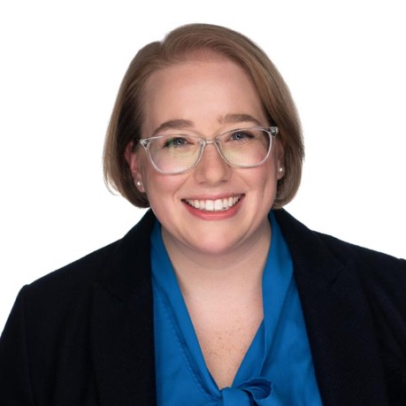
Meet the Rippel Presenters
Molly Belsky
Program Associate
Katherine Wright
Deputy Director, Strategic Initiatives

Slide 6
Intentions for Today’s Discussion
Introduce Thriving Together Theater, one of many tools to help stewards find a path from crisis to renewal
Share interconnected drivers that together affect who thrives, struggles, and suffers
Explore how different investment strategies alter trajectories and impact well-being

Slide 7
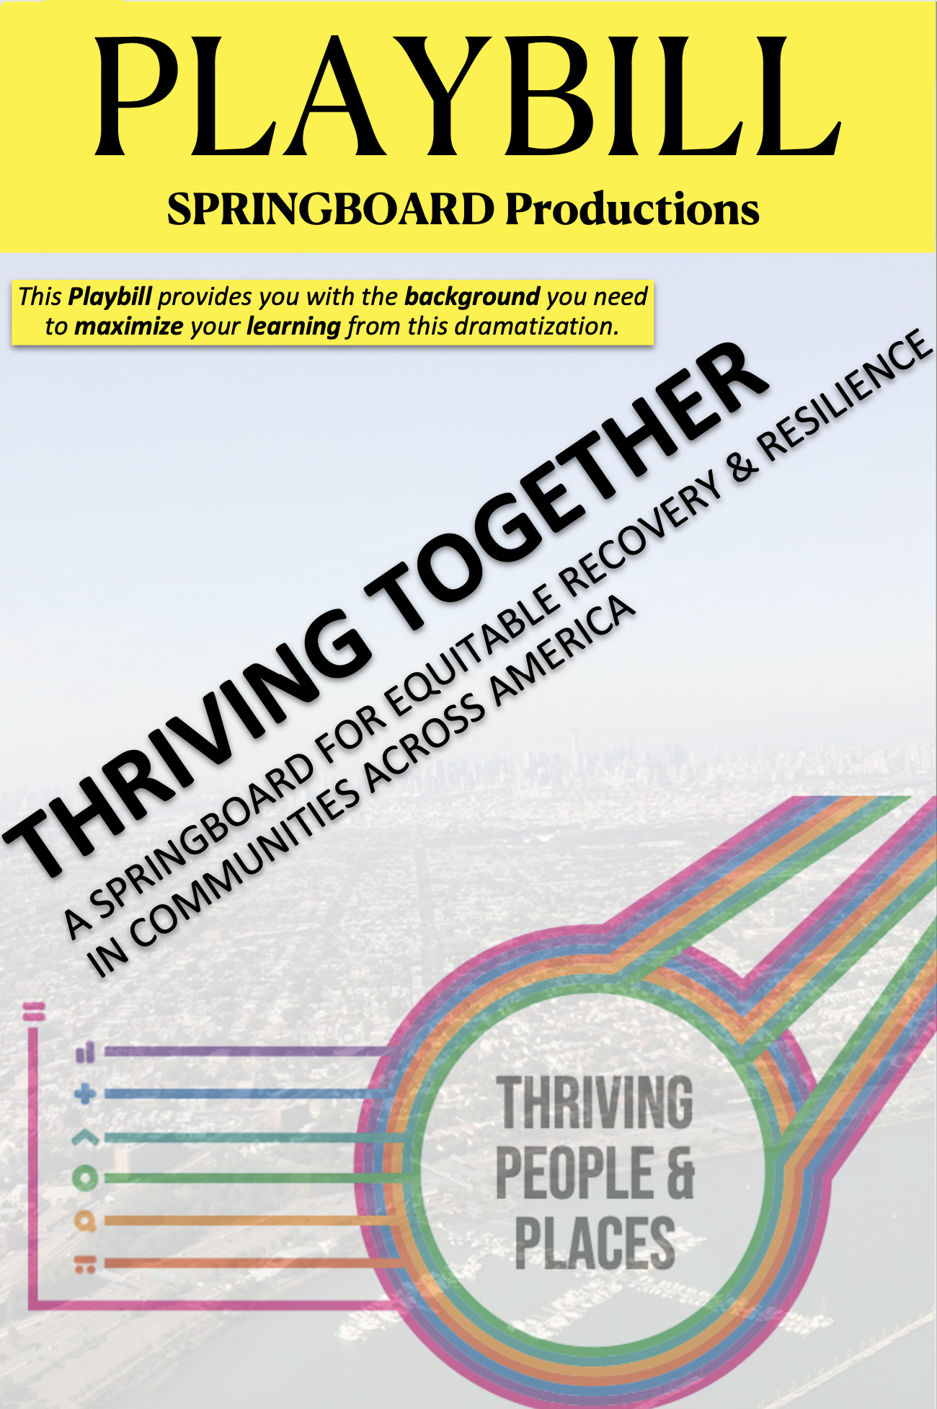
What is the Thriving Together Theater?
An immersive, simulated experience to help changemakers recover from an unjust shock
Participants play out the dynamics of recovery and renewal over a 10-year time horizon
Ability to experiment with various ways to balance investment priorities among vital conditions for health and well-being—including belonging and civic muscle, fairness in system design, and the adequacy of urgent services

Slide 8
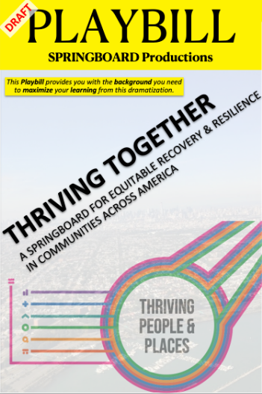
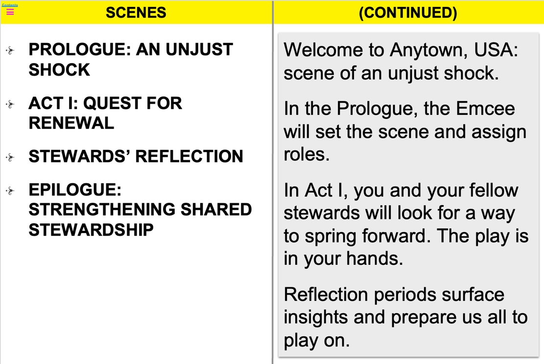
Playbill Table of Contents

Slide 9
Discuss and Negotiate with Your Peers
Simulate community recovery and long-term, sustainable resilience planning
Consider trade-offs involved investment decisions especially short-term vs. long-term planning
Have discussions that are needed for effective long-term planning
Practice multisolving necessary when working with different stakeholder groups

Slide 10
Welcome to Anytown USA

Slide 11
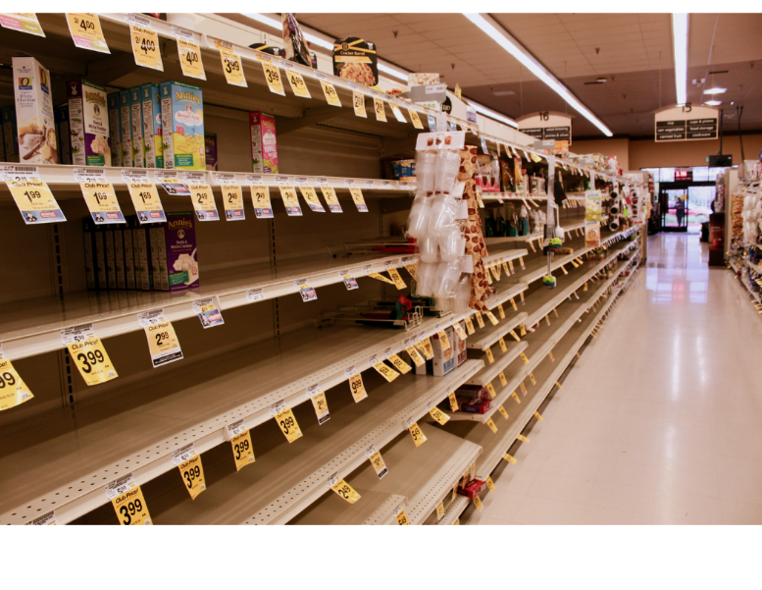
An Unjust Shock
“Everyone experienced what life was like under assault from an invisible threat.”

Slide 12
The Disruption to Anytown Residents
Thriving Struggling Suffering

Slide 13
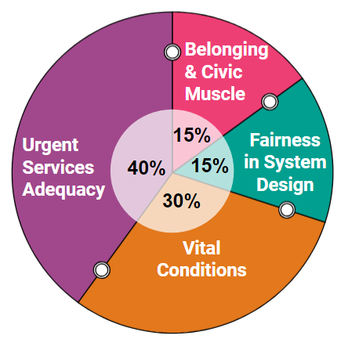
Your Challenge, Your Choices
Your Challenge
Find an equitable way to increase long, thriving lives and become better prepared to weather fitire challenges
You must…
NOT ONLY recover to pre-shock levels
But also renew and reach greater heights of well-being, equity, and resilience
You CAN PIVOT decisively—and not lose all previous gains
Your Choices
The following remained constant over several years pre-Shock…
The percent thriving, struggling, and suffering
All four drivers of well-being
Fellow-stewards consistently allocated community assets in the pie chart percentages

Slide 14
Four Drivers of Well-Being
Belonging and
Civic Muscle
Vital Conditions
Fairness in
System Design
Urgent Services Adequacy

Slide 15
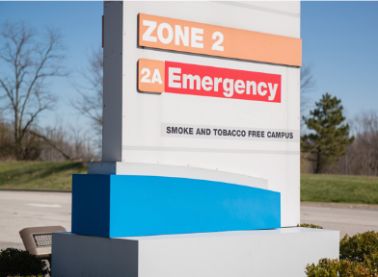
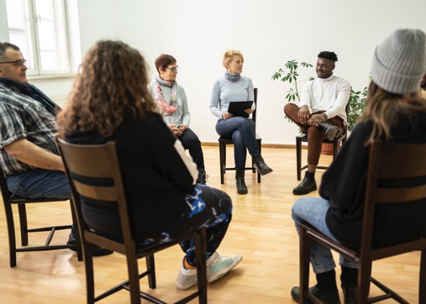
Urgent Services Adequacy describes the balance of supply and demand urgent services
Urgent services include:
Acute Care for Illness or Injury (mental or physical)
Addiction Treatment
Crime Response
Environment Cleanup
Homeless Services
Unemployment and Food Assistance
Belonging and
Civic Muscle
Vital Conditions
Fairness in
System Design
Urgent Services Adequacy

Slide 16
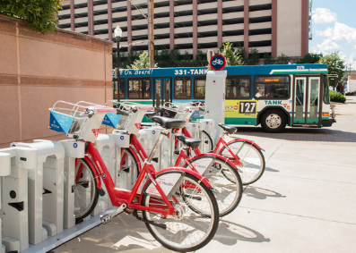
Vital Conditions are properties of places and institutions that all people need—all the time—to reach their full potential.
Vital Conditions include:
Thriving Natural World
Basic Needs for Health and Safety
Humane Housing
Meaningful Work and Wealth
Lifelong Learning
Reliable Transportation
Belonging and Civic Muscle
Belonging and
Civic Muscle
Vital Conditions
Fairness in
System Design
Urgent Services Adequacy
Note: Belonging and civic muscle is a vital condition, and a pragmatic necessity for success in every other area of work.

Slide 17
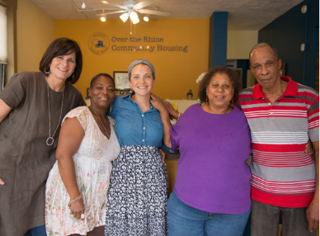
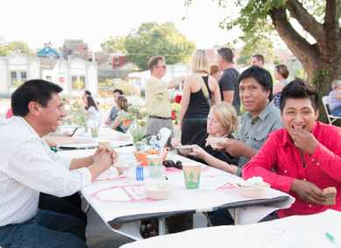
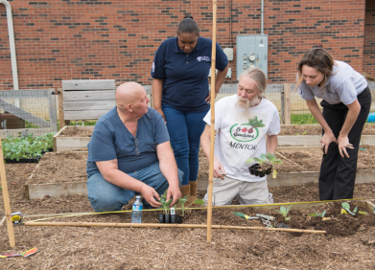
Belonging and Civic Muscle reflects whether people feel they belong and contribute to shape a common world. It is our power to work together so everyone can thrive.
Belonging and Civic Muscle is the shared community asset used to build all others.
Belonging and
Civic Muscle
Vital Conditions
Fairness in
System Design
Urgent Services Adequacy

Slide 18
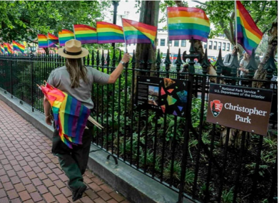
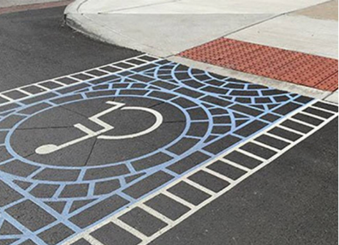
Fairness in System Design describes the extent to which there is fair and just inclusion for all people versus systemic exclusion (e.g., across color, class, gender, ethnicity, and other human differences). It reflects whether all people experience equitable opportunities and fair treatment, as a matter of system design, e.g.
Environmental
Economic
Housing
Food
Health Care
Education
Transportation
Civil Rights
Human Rights
etc
Belonging and
Civic Muscle
Vital Conditions
Fairness in
System Design
Urgent Services Adequacy

Slide 19
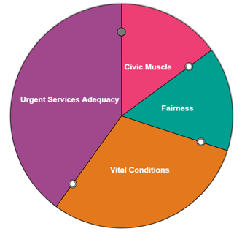
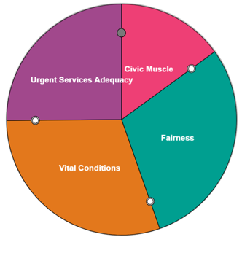
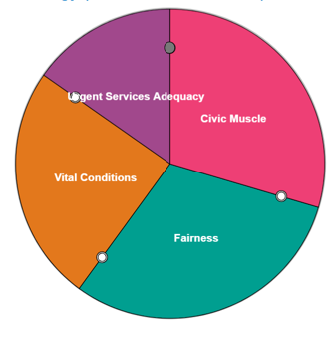
Allocate Resources to Each of the Four Drivers Over 10 Years…
Year of Shock
Year 2
Year 4
Year 6

Slide 20
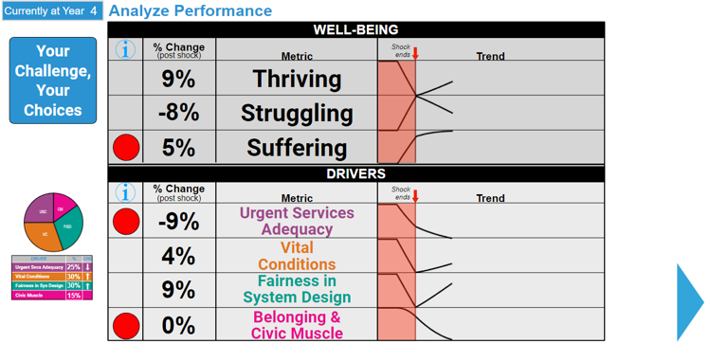
See the Results of Each Allocation

Slide 21
Flock to the Rescue
Meet Demand for Urgent Services
Strategy
Alleviate suffering above all
Make a modest move toward equity
Divert attention from vital conditions, as well as belonging and civic muscle
Notes:
Influences and choices are impacting wellbeing, life expectancy over 10 years
Which would be your instinct? Or give them 2 choices??? Flock to rescue or balance of the 4. In real life, we’ve seen both – why does balance work better? Bc there was investment in B&CM. Show screen shot of slides Bobby shared. NOW let’s pause and take a poll – which strategy would you choose? Closing: this is a tool that takes orchestration – organizing the right group, light facilitation, walks through what forum of how discussions like this inform public policy

Slide 22
Even Steven
Everything Is Important?
Strategy
Maintain 25% on each driver
Equal going forward, but a big change from past priorities
Equity (+10)
Belonging and Civic Muscle (+10)
Vital Conditions (-5)
Urgent Services (-15)

Slide 23
Which strategy do YOU think is best?
Flock to the Rescue
Even Steven
Something Else (put in chat which driver you’d pay special attention to!)

Slide 24
What has the Thriving Together Theater been used to support?
Conversations with policymakers about trade-offs in potential policies
Developing a state-wide health improvement plan
Building relationships in one region across residents and organizations
Enhance cohort learning across place and focus
Build momentum and excitement

Slide 25
Who has taken part in a Thriving Together Theater?
And more!

Slide 26
Putting Equitable Community Planning into Practice with the Thriving Together Theater
How might you use this tool with your colleagues?
Are there others in your network or partner orgs that you’d like to do this with?
What questions do you have about the theater?

Slide 27
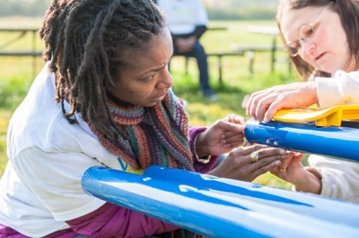
Learn More
Browse the following resources on Thriving Together Theater:
Rippel website – Learn by Topic
Healthy Communities Delaware: Shared Stewardship Series Video
Thriving Together Theater Playbill
Thriving Together Springboard
This paper published in System Dynamics Models for Public Health and Health Care Policy

Slide 28
Next Steps
Share feedback on today’s session
Surface stories of efforts to navigate a different future (including yours!) Write to Laila Hussain
Resource materials will be forthcoming

Slide 29
Notes:
Maggie’s email: mcooke@rippel.org

Slide 30
Get connected
Sign up for our emails and follow us on LinkedIn for updates on our work and curated resources on shared stewardship, vital conditions, and equitable health and well-being. Sign Up Here
Are you interested in partnering with us?
If so, please fill out this brief form.

Slide 31
This work may be used, photocopied, and distributed for
educational purposes only and as long as the copyright notice remains intact. For use on a website or social media platform, link directly to the work on our website. Unless prior written permission is given by The Rippel Foundation, this material may not be (i) used or distributed for monetary purposes (i.e., do not sell our work), and (ii) edited or changed in any way.
Please email requests or questions to: info@rippel.org

